Slide 1
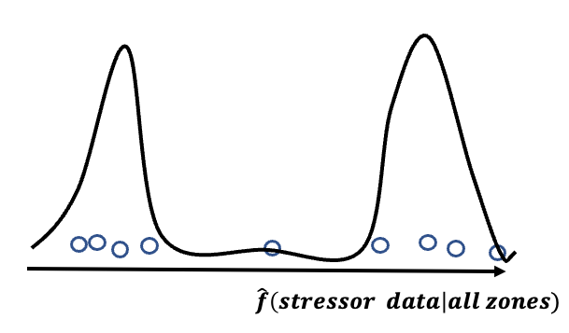
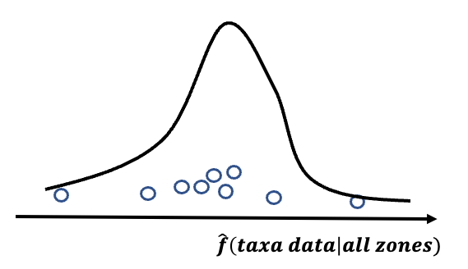
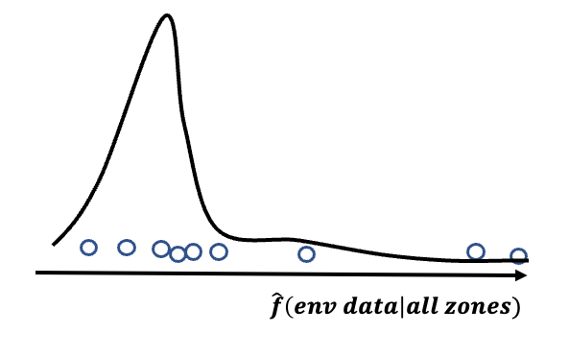
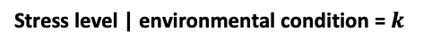
Collected data/
collected region
Detroit River
St. Clair Reiver
Lake St. Clair
Taxa data(311)
Environmental data(289)
Stressor data(104)
Infer the integrities of other stations
Stress level | environmental condition = $k$
condition on entire zone(three),
not only in Detroit River
Taxonomic composition

Slide 2
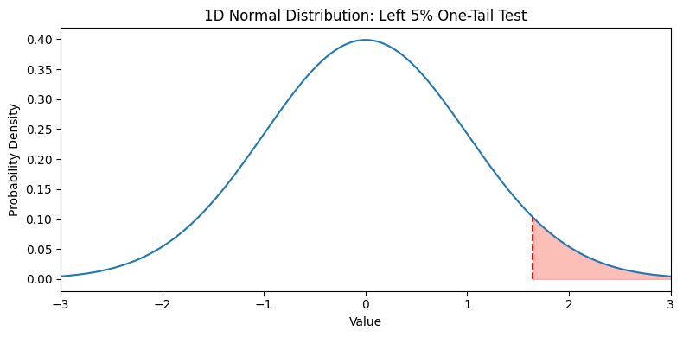
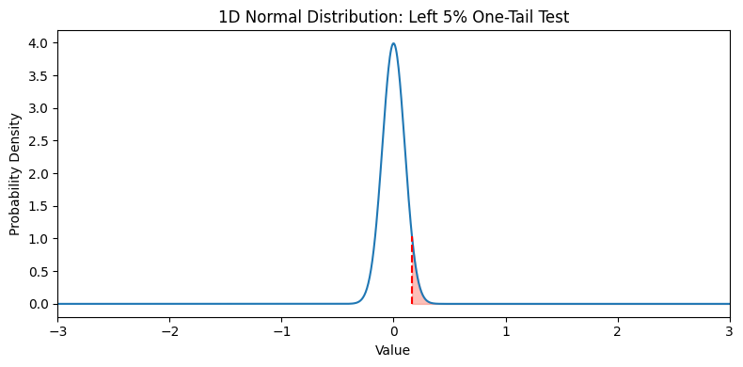
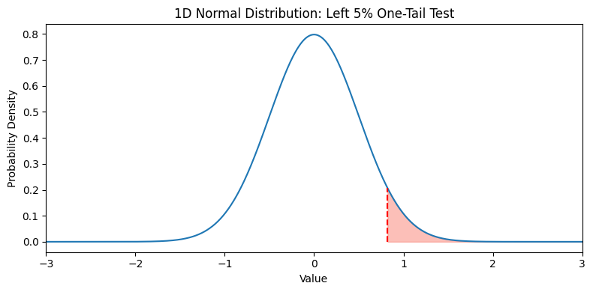
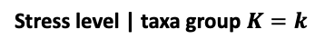
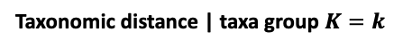
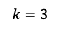
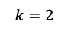
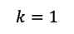
Taxonomic factor 2| reference sites
$$k=2$$
Probability density
$$k=1$$
$$k=3$$
Taxonomic factor 1| reference sites
Sediment contamination level
Probability density
Stress level | taxa group $K=k$
Probability of degraded
Sediment contamination level
Taxonomic distance | taxa group $K=k$
Taxonomic structure measurement

Slide 3
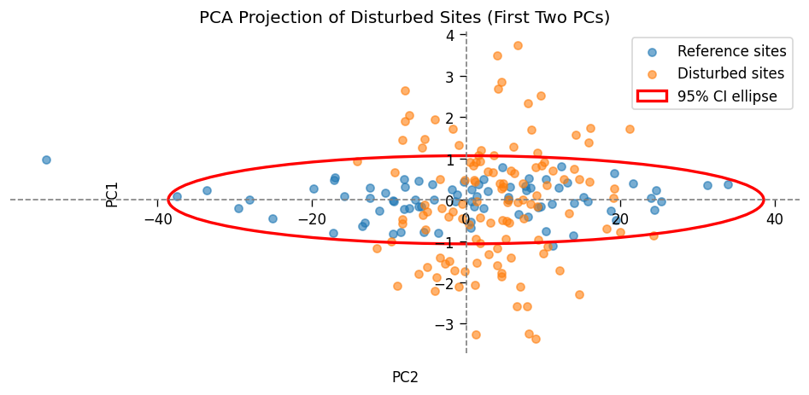





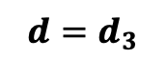
Probability density | $d=d_{3}$
Sediment contamination level
$$d=d_{3}$$
$$d=d_{2}$$
Probability density | $d=d_{1}$
$$d=d_{1}$$
Probability density | $d=d_{2}$
Sediment contamination level
Sediment contamination level

Slide 4
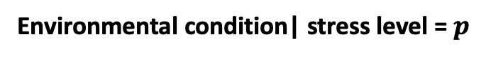
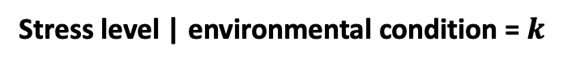
Taxonomic composition
Taxonomic composition
With control of other minor variables
Stress level | environmental condition = $k$
Taxonomic composition
Stress level |environmental condition = K
Environmental condition| stress level = $p$

Slide 5
Aquatic ecosystem
Human activities
Ecological reactions
Agricultural runoff
Bioaccumulation & toxicity
Industrial discharges
(cause sediment pollutants)
Zoobenthic community changes (responses of sediment organisms)
Urban storm water
Habitat degradation
More sources of pollutants
More ecological reactions

Slide 6
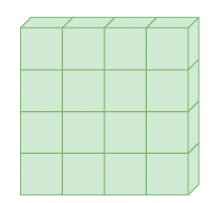
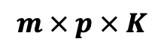
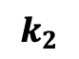
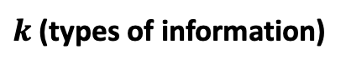
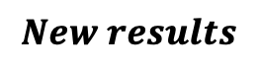
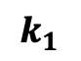
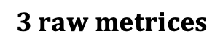
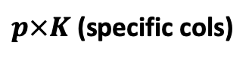
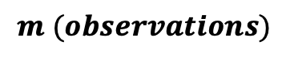
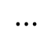
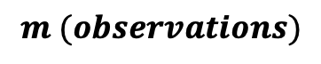
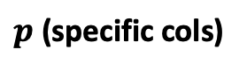
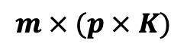
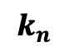
$$m (observations)$$
$$3 raw metrices$$
$$m (observations)$$
$$k_{1}$$
$$k_{2}$$
$$⋯$$
$$k_{n}$$
$$New results$$
$p$ (specific cols)
$p×K$ (specific cols)
$k$(types of information)
Flatten the tensor into a matrix
$$m × p × K$$
$$m × (p × K)$$

Slide 7
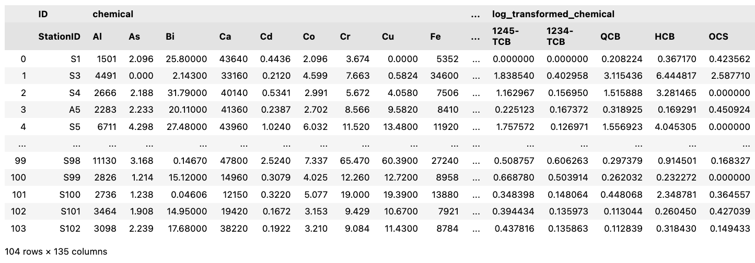
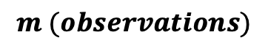
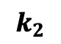
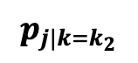
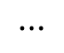
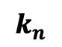
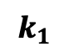
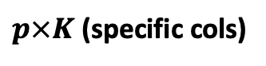
$$m (observations)$$
$$k_{1}$$
$$k_{2}$$
$$⋯$$
$$k_{n}$$
$$p_{j|{k=k}_{2}}$$
More columns
$p×K$ (specific cols)

Slide 8
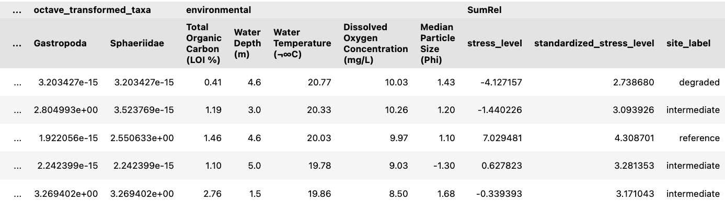
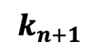
$$k_{n+1}$$

Slide 9
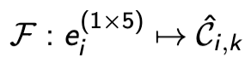
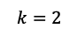
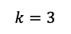
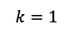
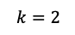
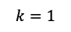
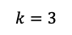
Fit
Apply
Other sites
Taxonomic factor 2| reference sites
Taxonomic factor 2| all sites
$$k=2$$
$$k=2$$
$$k=1$$
$$k=1$$
$$k=3$$
$$k=3$$
Taxonomic factor 1| reference sites
Taxonomic factor 1| all sites

Slide 10


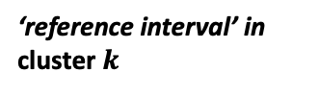


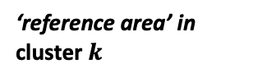

For$k=1, ⋯, K$
Taxonomic factor 2|cluster $k$
‘reference area’ in cluster $k$
‘reference interval’ in cluster $k$
$$⋯$$
Difference in taxa composition
Difference in taxa composition
Taxonomic factor | cluster $k$
Taxonomic factor 1| cluster $k$
One-dimentional measurement of taxa composition
Two-dimentional
higher-dimentional

Slide 11

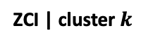





Probability density
$×:$ a fixed degraded threshold,
which will connect to quntile regression later
$$×$$
Stress level
‘degraded endpoint’ in cluster $k$
‘reference endpoint’ in cluster $k$
Distance - $d_{deg}$
Distance - $d_{ref}$
ZCI | cluster $k$
Details in one-dimentional measurement of taxa composition

Slide 12








The true distribution would never be known, and may not be necessary to know
Probability density|$ZCI=x$
$τ$ th quantile of Stress level
$$s_{τ}$$
$$×$$
Stress level
$$ZCI=x$$
$$ZCI$$
(distance to reference composition)
$×:$ a fixed degraded threshold
$s_{90\%}<threshold$: only 10% samples at this ZCI level support its degraded
The higher the $τ$ parameter is, the more safety it is to reject “not degraded” decision
$τ=1$: only all samples less than threshold supports to say “not degraded”
$τ≈0$: even one sample less than threshold supports to say “not degraded”

Slide 13

Taxa composition measured in two-dimensional space | Reference sites

Slide 14











Taxa composition measured in two-dimensional space | All sites
Probability density | $d=d_{3}$
$$p<0.05:$$
$$Yes, it is not degraded$$
$$×$$
Sediment contamination level
$$d=d_{3}$$
$$d=d_{2}$$
Probability density | $d=d_{1}$
$$d=d_{1}$$
Probability density | $d=d_{2}$
$$p>0.05:$$
$$No, it is degraded$$
$$×$$
$$p≈0.05:$$
$$emm, it is interesting$$
$$×$$
Sediment contamination level
Sediment contamination level

Slide 15

Taxa composition measured in two-dimensional space | All sites

Slide 16













$$\tilde{S}$$
$$\tilde{D}$$
$$\tilde{C}$$
$${\tilde{F}}_{reg}$$
$${\tilde{F}}_{discr}$$
$${\tilde{d}}_{11}{\tilde{, s}}_{12},{\tilde{c}}_{13, }{\tilde{f}}_{dis,14},{\tilde{f}}_{reg,15}$$
1$× 5$
Grid search
$$\tilde{D},\tilde{S},\tilde{C},{\tilde{F}}_{discr},{\tilde{F}}_{reg}$$
$$⋯$$
$$Z × 5$$
$${\tilde{d}}_{Z1}{\tilde{, s}}_{Z2},{\tilde{c}}_{Z3, }{\tilde{f}}_{dis,Z4},{\tilde{f}}_{reg,Z5}$$
1$× 5$

Slide 17


Slide 18


clear, maintainable, extendable
raw chemical data
Log-trans chemical data

Slide 19
Pollution data
Environmental data
Taxa data

Slide 20
Taxonomic composition
More interesting to us
Taxonomic composition
With control of other minor variables
Stress level | environmental condition = $k$
Taxonomic composition
Stress level |All environmental condition
Environmental condition| stress level = $p$

Slide 21













To a site $i$, its environmental condition and reference community composition are $e_{i}, s_{ref, i}$:
$$reference site i=(e_{i},t_{i}^{′})$$
$${ S}_{ref, j}∈\left\{s_{ref, 1},…,s_{ref, m}\right\}$$
$$t_{1}^{′}$$
$$…$$
$$t_{2}^{′}$$
$$…$$
$$…$$
$$t_{n}^{′}$$
Measurement
$$e_{1}$$
$$…$$
$$e_{2}$$
$$…$$
$$…$$
$$e_{n}$$
Tick mark
An ruler of environmental condition for perfect community composition (conterfactual)
$$f:e_{k}→ s_{ref, k}$$

Slide 22













Example:
If there was a site $i$ that has its environmental condition as $e_{i}.$
Align the site to the ruler with its tick - $e_{i}$, we can read a reference community structure for this site.
$$s_{ref, 1}$$
$$…$$
$$s_{ref, 2}$$
$$…$$
$$s_{ref, i}$$
$$…$$
$$s_{ref, n}$$
$$e_{1}$$
$$…$$
$$e_{2}$$
$$…$$
$$e_{i}$$
$$…$$
$$e_{n}$$
This reading value - $s_{ref, i}$, is how the community structure looks like in environmental condition - $e_{i}$ without human disturbance.

Slide 23








Reference sites are exclusively needed for constructing this env-ref structure ruler.
Availability of the three data sets influence how we constructure this ruler and its measurement accuray.
$$s_{ref, 1}$$
$$…$$
$$s_{ref, 2}$$
$$…$$
$$s_{ref, i}$$
$$…$$
$$s_{ref, n}$$
Measurement
$$e_{1}$$
$$…$$
$$e_{2}$$
$$…$$
$$e_{i}$$
$$…$$
$$e_{n}$$
Tick mark

Slide 24











Reference sites selection – contamination level assessment.
Data for training the ruler (how to keep the quality of the training set?)
Selected reference sites
$$s_{ref, 1}$$
$$…$$
$$s_{ref, 2}$$
$$…$$
$$s_{ref, i}$$
$$…$$
$$s_{ref, n}$$
Measurement
$$e_{1}$$
$$…$$
$$e_{2}$$
$$…$$
$$e_{i}$$
$$…$$
$$e_{n}$$
Tick mark

Slide 25










One way to construct the Measurement of the ruler.
Hierarchical clustering labels as an enter-level measurement, there are meta-information about reference community structure kept in them
$$C_{1}$$
$$C_{2}$$
$$…$$
$$C_{k}$$
$$s_{ref, 1}$$
$$…$$
$$s_{ref, 2}$$
$$…$$
$$s_{ref, i}$$
$$…$$
$$s_{ref, n}$$
Measurement
$$e_{1}$$
$$…$$
$$e_{2}$$
$$…$$
$$e_{i}$$
$$…$$
$$e_{n}$$
Tick mark

Slide 26














One way to align the Measurement and Tick Mark.
Train a discriminant function:
Fit
Fit
Environmental variable 2| reference sites
Environmental variable 2| reference sites
$$k=i$$
or
Or …
$$k=1$$
$$k=1$$
$$k≠1$$
$$k=3$$
Environmental variable 1| reference sites
Environmental variable 1| reference sites
$$C_{1}$$
$$…$$
$$C_{2}$$
$$…$$
$$C_{j}$$
$$…$$
$$C_{n}$$
Measurement
$$e_{1}$$
$$…$$
$$e_{2}$$
$$…$$
$$e_{i}$$
$$…$$
$$e_{n}$$
Tick mark

Slide 27














Apply the fitted discriminant function(use the ruler)
What we expect to see is that:
If the site $i$ has been polluted with a disturbed community structure, the observed structure and the readout from the ruler will not equal.
Apply
Other sites
Environmental variable 2| all sites
$$k=j$$
Observaed
$$t_{i}$$
Difference in community structure appears (ZCI)
$$k=1$$
Pollution appears
$$≠$$
$$k=3$$
Environmental variable 1| all sites
$$C_{1}$$
$$…$$
$$C_{2}$$
$$…$$
$$C_{j}$$
$$C_{n}$$
Measurement
Ideal
$$e_{1}$$
$$…$$
$$e_{2}$$
$$…$$
$$…$$
$$e_{i}$$
$$e_{n}$$
Tick mark

Slide 28
















One example site $i$
In the corresponding cluster $j$:
Probability density
Observaed
$$t_{i}$$
$×:$ a fixed degraded threshold,
connects to Quntile Regression
Pollution appears
(stress level)
Difference in community structure appears (ZCI)
$$≠$$
$$×$$
Stress level
Distance - $d_{deg}$
Distance - $d_{ref}$
Ideal
$$C_{j}$$
Site $i$
ZCI | cluster $j$
‘reference endpoint’ in cluster $k$
‘degraded endpoint’ in cluster $k$
$$e_{i}$$
What expected to see in one-dimentional measurement of community structure

Slide 29

One example site $i$
In the corresponding cluster $j$:
Probability density
Observaed
$$t_{i}$$
$×:$ a fixed degraded threshold,
connects to Quntile Regression
Pollution appears
(stress level)
Difference in community structure appears (ZCI)
$$≠$$
$$×$$
Stress level
Distance - $d_{deg}$
Distance - $d_{ref}$
Ideal
$$C_{j}$$
Site $i$
ZCI | cluster $j$
‘reference endpoint’ in cluster $k$
‘degraded endpoint’ in cluster $k$
$$e_{i}$$
What expected to see in one-dimentional measurement of community structure

Slide 30
Probability density|$ZCI=x$
$τ$ th quantile of Stress level
$$s_{τ}$$
$$×$$
Stress level
$$ZCI=x$$
$$ZCI$$
(distance to reference composition)
$×:$ a fixed degraded threshold
$s_{90\%}<threshold$: only 10% samples at this ZCI level support its degraded
The higher the $τ$ parameter is, the more safety it is to reject “not degraded” decision
$τ=1$: only all samples less than threshold supports to say “not degraded”
$τ≈0$: even one sample less than threshold supports to say “not degraded”

Slide 31








$$disturbed site ′j′:(e_{j},t_{j},s_{j})$$
$${dis}_{ref}= \left\{(e_{1},t_{1},s_{1}),…,(e_{j},t_{j},s_{j})\right\}$$
$$t_{1}^{′}$$
$$…$$
$$t_{2}^{′}$$
$$…$$
$$t_{n}^{′}$$
$$…$$
$$t_{n}^{′}$$
$$e_{1}$$
$$…$$
$$e_{2}$$
$$…$$
$$e_{n}$$
$$e_{i}$$
$$…$$
$$e_{n}$$
Tick mark
The ruler measurement that controls
environmental confound
The measured taxa composition difference(distance) between $t_{j}$ and $t_{j}^{′}$

Slide 32

















A disturbed site $j:(e_{j},t_{j},s_{j})$
With control of environmental confounding:
$$t_{j}$$
Observed taxa composition
Probability density | $d=d_{1}$
Probability density | $d=d_{2}$
Shapes uncertainty
Shapes uncertainty
Pollution appears
($s_{j}≠0$)
$$⟹$$
$$t_{j}≠ t_{j}^{′}$$
Deterministic part
Deterministic part
$$×$$
$$×$$
Contamination level
Contamination level
Ideal taxa composition
$$t_{j}^{′}$$
If there is a deterministic part$: f(s_{j})$
$d_{1}$
$d_{2}$
site j
ref sites cluster
site q
Taxa measurement
$$e_{i}$$
What expected to see in one-dimentional measurement of community structure
$×$: could be an interested contamination level, like degraded threshold

